Slide 1
Motown
By: Student Name

Slide 2
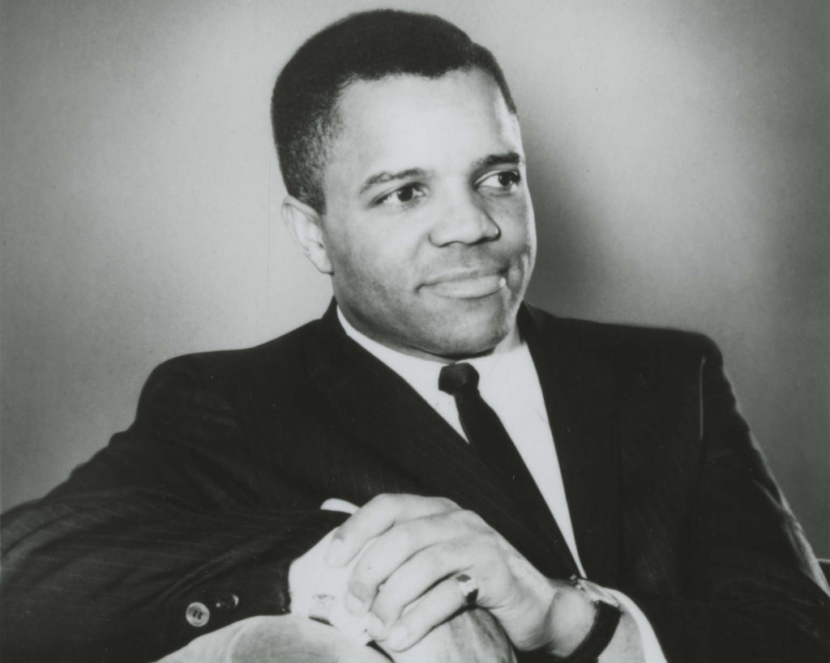
Introduction to Motown
Formed in July 1959 by Berry Gordy Jr., in Detroit. The revolutionized music industry through a fusion of sou, pop and R&B.959 in Detroit.
Revolutionized the music industry by blending sou, pop, and R&B.
Revolutionized America’s music, and inspired many musicians and musical styles.
Founder of Motown Berry Goedy jr

Slide 3
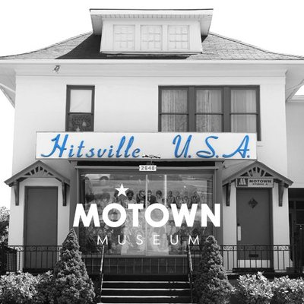
The Birth of Motown
Motown started in Detroit Michigan they called it the Motor City (Ratledge et al. 88).
Gordy original dream was to produce music for blacks and whites at the same time, or what most commonly known today as the crossover appeal.
Motown was dubbed the “Sound of Young America.

Slide 4
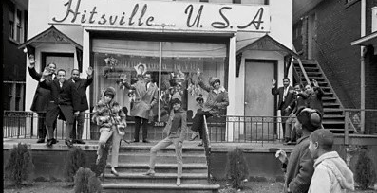
Functions of Motown in Changing Racial Relations
Essential to shattering racial integration barriers on main stream music scene during 1960s (Coddington 47).
Offered a number of successes to African-American artists in a country that was racially segregated.
Main events in musical racial desegregation.

Slide 5
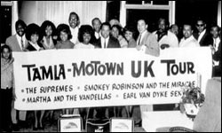
Key Figures in Motown
Berry Gordy Jr.: The man who founded Motown and was the main force in its success.
Stevie Wonder, Marvin Gaye, Diana Ross & The Supremes, The Temptations, Smokey Robinson: Legendary singers who really made Motown famous.

Slide 6
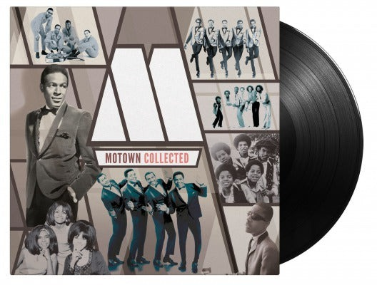
The Motown Sound
A product line of rhythm and blues, soul, and pop music.
Famous for their chorus lines, and drum and bass lines beats, and then perfected vocals.
They produced great pieces of work that I would consider classics.

Slide 7
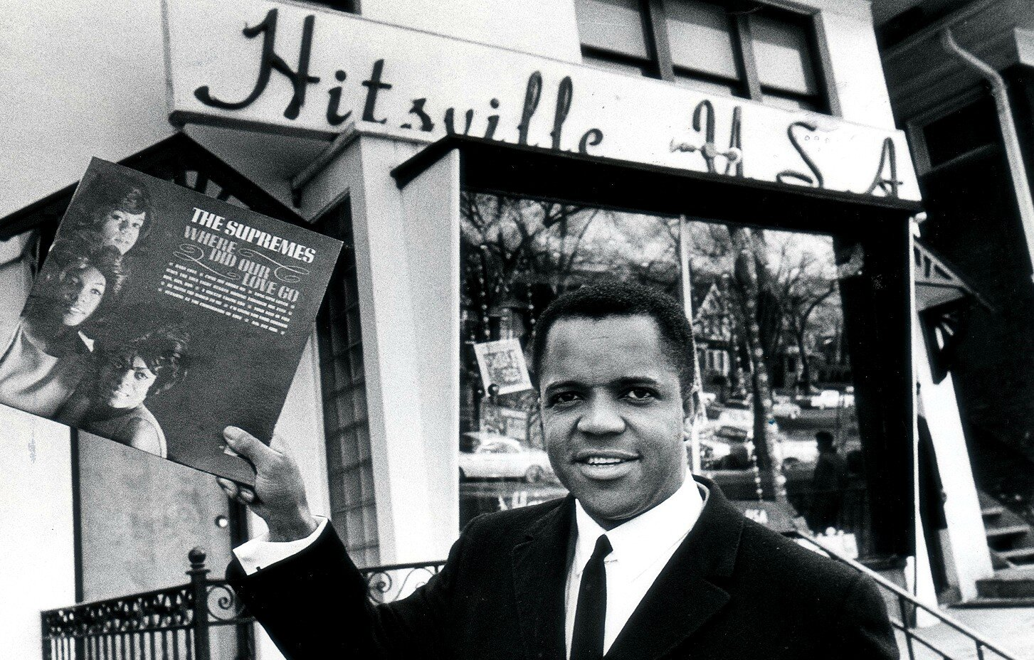
Contemporary show and Impact
Motown also had songwriting and production crews a novelty and had some of the brightest talents like Holland-Dozier-Holland.
It is important to note that Motown played a significant contribution to the emergence of such genres as disco, hip-hop, and the modern pop.
Its sound help to set the manner in which popular music production sound at that period of time.

Slide 8
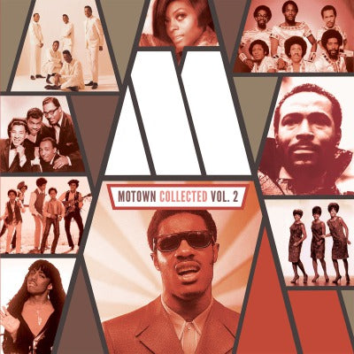
The Motown Hit Factory
The Motown Company dubbed the Hitsville U.S.A. studio in Detroit a base for official production of many records that yielded high ratings.
The concept of assembling the artists like the famous Motown ‘Assembly Line’, led to intense creation of presenting all possible music hits as fast as possible.
Key productions: My Girl by The Temptations, Stop! These include: “In The Name Of Love” by The Supremes, “What’s Going On” by Marvin Gaye and others.

Slide 9
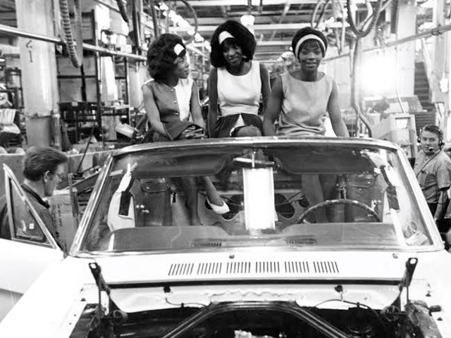
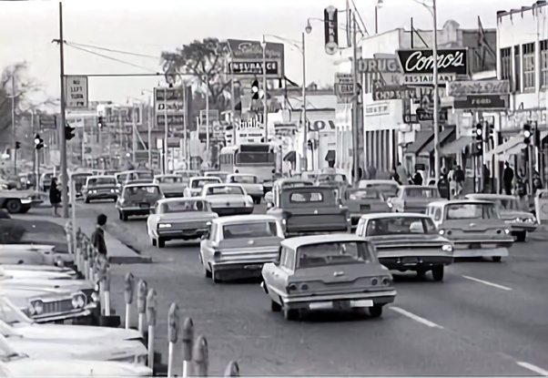
Cultural Impact
Motown music represented black achievement and integration of the white public with blacks.
Some artists became popular in mainstream pop charts, estimated and accepted like The Supremes and later Marvin Gaye.
In essence, Motown’s influence span herbal products, fashion and even dance and popular culture.

Slide 10
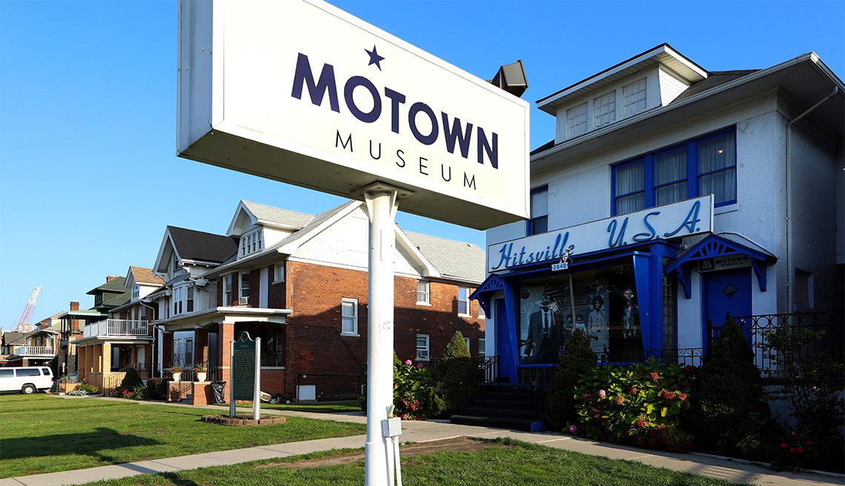
Legacy and Memorials
Motown Museum founded in Detroit also tells the history and experience Motown left behind and the changes it brought into the society.
In the recent films, Dream girls and tribute shows all over the world, Motown’s presence is eminent.
The influences are also preserver today with artists mentioning Motown as their source of inspiration.

Slide 11
Fun Fact – The Move to LA
In the early 1970s Berry Gordy relocated Motown from Detroit to Los Angeles in the hope of diversifying into new fields in the entertainment industry.
Such transition was a turning point in the label’s development history and began paying more attention to the film and television industry.

Slide 12
Problems and Reversal in the 1970s
During the 1970’s Motown began to experience some internal problems, problems with artists and management personnel.
Some of them included Michael Jackson – The Jackson 5, and Diana Ross who all faded off and this was the main reason that made Motown lose its dominance.
New music trends and creative freedom problems effectively brought the company down in the traditional music business.

Slide 13
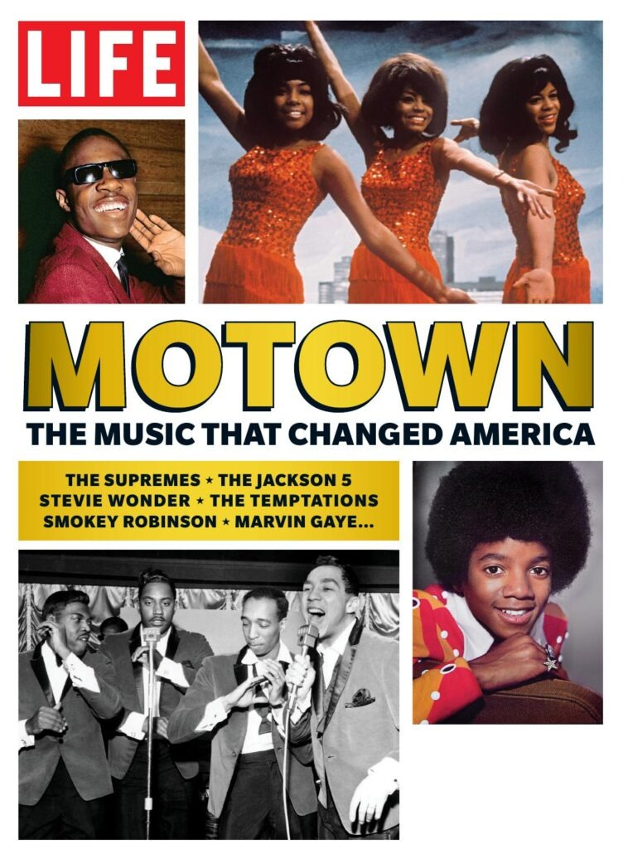
Conclusion
Motown today is still an important foundation of America’s musical legacy, which expanded the frontiers of pop, rhythm and blues and soul. can music history, reshaping pop, R&B, and soul.
The cultural value of the label remains up to date in inspiring artists, musicians and fan base across the world. Nevertheless, Motown’s creativity along other social aspects can still be felt to date.

Slide 14
Q&A
- What was Motown Sound and how did it impact the music mainstream?.
- What there was about Motown that made it change the manner in which music was racially integrated in the 1960s?
-Motown and its various records could be looked at in terms of what difficulties were encountered throughout the 1970s, and how these impacted on Motown.
Notes:
-Motown Sound: A mix of r & b, pop and soul with great hook lines and crystal clear arrangements. Racial Integration: Motown integration: impacts on a racial integration in mainstream pop music Analyzing the specific period of the Motown industry in the 1970s: Problems: Loss of artists, with artists demanding more control over the music; changes in musical markets.

Slide 15
Works Cited
Coddington, Amy. "A “Fresh New Music Mix” for the 1980s: Broadcasting Multiculturalism on Crossover Radio." Journal of the Society for American Music 15.1 (2021): 30-59.
Ratledge, Alyssa, et al. "Motor City Momentum: Three Years of the Detroit Promise Path Program for Community College Students." MDRC (2021).88

